Slide 1

DESIGN ASSIGNMENT - 1
EC22B1011 - SONU
Ec22b1014 – ADVIK
EC22B1021 – NIKITA N A
EC22B1063 – P SAMARESH

Slide 2
QUESTION 1:
1. List down the concept/idea that you have finalized as a team (as listed in the Google form):
Our team has finalized the concept of a Smart Shopping Cart that automates product scanning during shopping to reduce checkout times and improve customer experience.
Problem Statement definition: List the Problem/ Opportunity the team is planning to solve/address (Mention in Bullets points) :
Long queues in grocery stores lead to customer frustration and time inefficiency.
Shoppers with only a few items must wait behind those with full carts, leading to dissatisfaction.
Customers may abandon purchases or prefer online shopping to avoid long queues, impacting retailer’s sales.
Validate with peer groups (two other teams ) about the problem and your proposed concept.
Method Used:
We conducted in-person feedback with peer teams, asking them to review our problem and solution and offer suggestions.

Slide 3
4. Record their feedback:
Team 1 Feedback:
They appreciated the idea and suggested ensuring that the system supports different product sizes and shapes for efficient scanning. They also recommended a purchase tracking feature to boost customer engagement.
Team 2 Feedback:
They liked the concept and proposed integrating a “self-checkout summary” on the cart's screen, allowing users to review scanned items and make edits before finalizing the purchase. This would help prevent errors and improve trust in the system.
5. Insights/Conclusion Based on Feedback:
We'll focus on optimizing the cart for accurate scanning of various products and ensure transparency by adding a self-checkout summary on the cart's display. These features will enhance user trust and improve the overall experience.

Slide 4
QUESTION 2:
EXERCISE 2.1 :
List prominent entrepreneurs & managers relating to your product / industry:
1. Apoorva Mehta (Founder of Instacart):
Motive: Revolutionized grocery shopping by enabling customers to order online and receive home deliveries.
Relevance: Aligns with the smart shopping cart concept by enhancing efficiency and convenience in grocery shopping, aiming to reduce friction in the customer journey.
2. Dilip Kumar (VP of Technology, Amazon Go):
Motive: Developed Just Walk Out technology that allows shoppers to skip checkout lines entirely.
Relevance: Directly relates to the smart shopping cart’s goal of eliminating long queues and automating the checkout process for a seamless shopping experience.
3. Brian Cornell (CEO of Target Corporation):
Motive: Focused on integrating technology to improve both online and in-store shopping experiences.
Relevance: His innovations support the smart shopping cart initiative, which seeks to streamline in-store grocery shopping and enhance customer satisfaction.

Slide 5
4. Tony Xu (Co-founder of DoorDash)
Motive: Created an efficient platform for food delivery, optimizing last-mile logistics.
Relevance: Similar to DoorDash, the smart shopping cart aims to improve the in-store shopping journey by speeding up product scanning and checkout processes.
5. Albinder Dhindsa (Co-founder of Blinkit, formerly Grofers)
Motive: Aimed to accelerate grocery delivery through technology, providing a faster shopping experience.
Relevance: Supports the goal of the smart shopping cart by focusing on automating in-store processes to minimize checkout times.
6. Hari Menon (Co-founder of BigBasket)
Motive: Simplified grocery shopping by offering a wide online product range with home delivery.
Relevance: The smart shopping cart mirrors BigBasket's tech-driven approach, striving to enhance the physical grocery shopping experience and reduce waiting times.
7. Devendra Chawla (CEO of Spencer’s Retail)
Motive: Enhanced in-store shopping through a technology-driven retail approach.
Relevance: Aligns with the smart shopping cart’s purpose of minimizing long queues and improving the overall shopping experience.

Slide 6
EXERCISE 2.2 :
Is your product concept a good or a service? Why?
The smart shopping cart concept combines elements of both a good and a service. It primarily serves as a physical product (good) designed to enhance the service of grocery shopping.
The cart itself is a tangible item (good) equipped with technologies such as automated scanning and checkout, which provide a service-oriented solution by improving efficiency and convenience in grocery stores.
Find out which industry and sector does it belong to? Why?
The smart shopping cart concept belongs to the retail industry, specifically the grocery sector. This sector encompasses businesses involved in the sale of food and household goods, typically through physical stores.
The smart shopping cart’s integration of technology to automate and streamline the shopping process directly addresses challenges within the grocery retail sector, aiming to enhance customer experience and operational efficiency

Slide 7
EXERCISE 2.3 :
• List 10 firms in your product/industry (5 Indian, 5 global) and their ownership :
1. Indian firms:
BigBasket (Owned by Tata Digital):
Ownership: Acquired by Tata Group; a subsidiary of Tata Digital.
Relevance: Primarily an online grocery store, BigBasket is expanding into physical stores. Smart carts can streamline in-store shopping and integrate with their digital ecosystem.
D-Mart (Avenue Supermarts):
Ownership: Publicly traded.
Relevance: D-Mart is known for its cost-efficient retail operations. Smart carts could increase efficiency and customer convenience in their chain of hypermarkets.
More (Aditya Birla Retail):
Ownership: Private (recently acquired by Amazon and Samara Capital).
Relevance: More operates supermarkets and hypermarkets across India. Given Amazon’s involvement, integrating smart carts seems a natural progression in improving their retail operations.

Slide 8
Patanjali Ayurved
Ownership: Privately held.
Sector: FMCG, retail.
Relevance: Patanjali operates across large-format stores, where smart carts could reduce checkout times.
Reliance JioMart:
Ownership: Privately owned by Reliance Industries.
Relevance: JioMart is expanding its presence both online and offline, making smart shopping carts a perfect addition to their in-store operations.
2. Global Firms:
Amazon Go (Amazon)
Ownership: Publicly traded (Amazon).
Relevance: Amazon Go stores use "just walk out" technology, directly relevant to smart shopping carts.

Slide 9
Alibaba (Freshippo)
Ownership: Publicly traded (Alibaba).
Relevance: Freshippo stores use automation extensively, blending online and offline retail experiences.
Marks & Spencer
Ownership: Publicly traded.
Relevance: M&S has been integrating tech to improve in-store customer experiences, where smart carts could fit.
Tesco
Ownership: Publicly traded.
Relevance: Tesco, one of the largest grocery retailers in the UK, has invested in automation, making smart carts a natural fit for their large stores.
Walmart
Ownership: Publicly traded.
Relevance: Walmart invests heavily in retail technology to improve store operations, making it a strong player in automation.

Slide 10
• Discuss the pros and cons of these ownership models
Pros and Cons of Ownership Models
Privately Owned Firms (e.g., Reliance Retail, Aldi, More)
Pros:
Flexibility in Decision-Making: Private companies can make strategic decisions without the pressure of short-term shareholder expectations. They have more freedom to experiment with innovative technologies like smart carts.
Long-Term Focus: These firms can focus on long-term goals and investments in technology without needing to meet quarterly earnings targets, allowing for sustained investment in retail innovations.
Quick Adaptation: Private ownership can lead to faster decision-making and the ability to adapt swiftly to technological changes.
Cons:
Limited Access to Capital: Since private companies do not trade on the stock market, raising large amounts of capital for significant tech investments, such as widespread deployment of smart carts, can be more challenging.
Transparency Issues: Private firms are not subject to the same level of regulatory and financial transparency as publicly traded companies, which could impact trust with consumers or partners.

Slide 11
Publicly Traded Firms (e.g., Amazon, Walmart, Tesco, D-Mart)
Pros:
Access to Capital: Public companies can raise large amounts of capital by issuing shares. This makes it easier to fund large-scale innovations, such as implementing smart shopping carts across multiple store locations.
Market Visibility: Being publicly traded increases a company’s visibility, which can attract more partnerships and opportunities to collaborate on technological advancements.
Accountability and Transparency: Public companies must adhere to strict reporting standards, ensuring accountability and providing a clear understanding of the company’s financial health, which can boost investor and consumer confidence.
Cons:
Short-Term Pressure: Publicly traded companies often face pressure from shareholders to meet quarterly earnings targets. This can limit their ability to focus on long-term technology investments, including R&D for innovations like smart carts.
Market Vulnerability: Stock prices can be volatile, influenced by market trends that may not always align with the company’s long-term technological goals. This can affect funding for innovation projects.

Slide 12
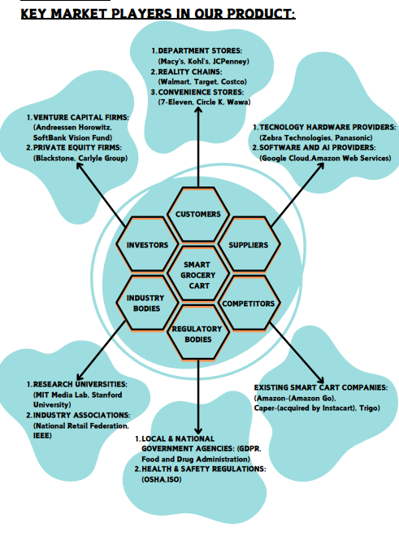
QUESTION 3:
EXERCISE 3.1:
• List the key market players
for your product / company

Slide 13
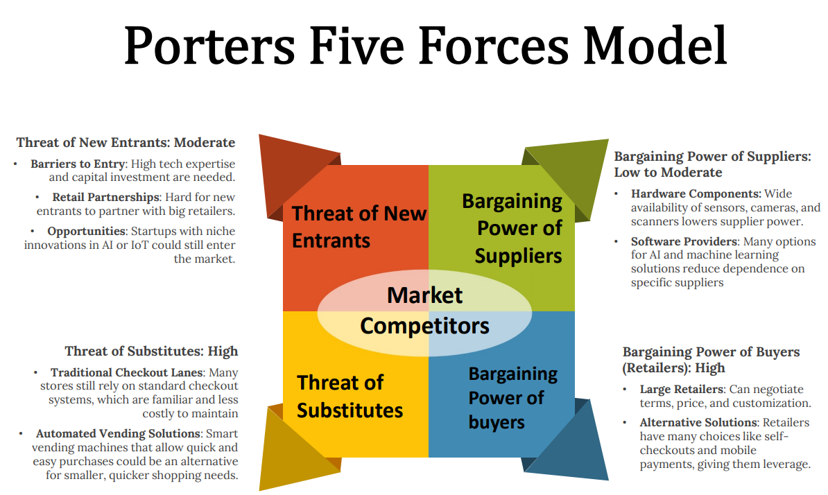
EXERCISE 3.2:
• Analyze competitive forces for your product-industry (Porter’s five forces)

Slide 14
QUESTION 4:
EXERCISE 4.1:
Explain the factors of Product-Market fit for a video streaming service:
1. Content Selection:
Diverse Library: A wide variety of genres, including movies, TV shows, documentaries, and live events, appeals to broad audiences.
Localized Content: Offering regional and language-specific content caters to niche markets.
Timeliness: Providing access to the latest releases and highly anticipated shows boosts subscriptions.
2. User Experience (UX):
Ease of Navigation: An intuitive, easy-to-use interface helps users find content effortlessly.
Personalized Recommendations: AI-driven suggestions based on user preferences enhance engagement.
Cross-Device Compatibility: Seamless streaming on multiple devices (phones, TVs, tablets) improves convenience.
3. Pricing and Subscription Models:
Affordability: Flexible pricing plans (monthly, yearly, ad-supported, premium tiers) attract diverse customer segments.
Free Trials and Promotions: These incentives bring in new users, allowing them to test the service before subscribing.
Value Proposition: Offering exclusive content, superior streaming quality, or extra features justifies the subscription cost.

Slide 15
4. Technology and Performance:
Streaming Quality: High-definition, 4K, and reliable, buffer-free streaming are crucial for user satisfaction.
Offline Access: The ability to download content for offline viewing enhances usability, especially in areas with unstable internet.
Bandwidth Efficiency: Adaptive streaming ensures consistent quality for users with varying internet speeds.
5. Market Demand and Competition:
Target Audience: Tailoring content and marketing strategies to user preferences (e.g., binge-watchers, families) strengthens market fit.
Competitor Analysis: Standing out from rivals like Netflix or Disney+ through unique offerings, features, or superior UX is key.
Niche Focus: Specializing in niches like anime (Crunchyroll) or sports (DAZN) can create strong product-market fit.

Slide 16
EXERCISE 4.2:
What are the factors associated with your proposed product /service
SWOT Analysis of the Smart Grocery Cart:
Strengths:
Convenience: Hands-free checkout by scanning items automatically.
Innovation: Leading-edge technology positions it as a market leader in retail automation.
Accuracy: Reduces human errors during checkout, improving efficiency.
Weaknesses:
High Initial Cost: Expensive sensors, software, and maintenance.
Technical Issues: Challenges in scanning certain items like damaged barcodes.
Maintenance and Downtime: Technical failures can disrupt operations and increase costs.
Opportunities:
Contactless Shopping: Rising demand for touch-free shopping post-pandemic.
Partnerships: Potential collaborations with tech companies and retailers.
Data Insights: Helps optimize inventory and marketing through customer data.
Eco-friendly Branding: Reduces labor, paper, and energy use.

Slide 17
Threats:
Competition: Other companies could create similar or better technologies.
Technical Malfunctions: Software issues could damage customer experience.
Customer Resistance: Some may prefer traditional methods, slowing adoption.
Data Security: Privacy concerns may create legal or reputational risks.
Good Strategy:
Focus on seamless, user-friendly customer experiences.
Promote the innovative edge through marketing.
Ensure data privacy compliance and transparent communication.
Differentiate with continuous improvement and added features.
Bad Strategy:
Failing to assist customers or skipping product testing.
Setting unclear objectives or overestimating immediate adoption.

